Slide 1
TX FIR Equalizer
12 Gbps
(Eye Diagram)
Muhammad Aldacher

Slide 2
Design Parameters
Parameter | Value
Data Rate | 12 Gb/s
VDD | 1 V
Tx-Driver | Current Mode (CML)
VSWING (PK2PK) | 0.5 V
IBIAS | 10mA
Channel | 12-inch FR4

Slide 3
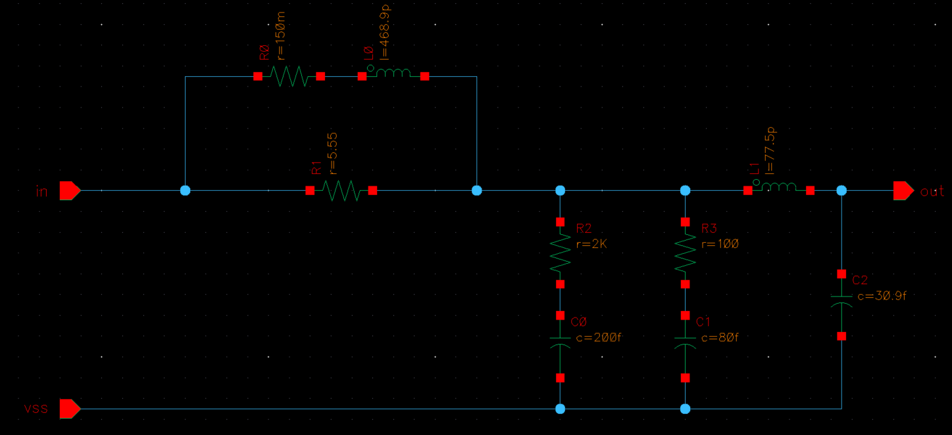
Channel = 12 x 1-inch FR4 section
1-inch FR4 section

Slide 4
1) Eye Diagram (without Equalization)

Slide 5
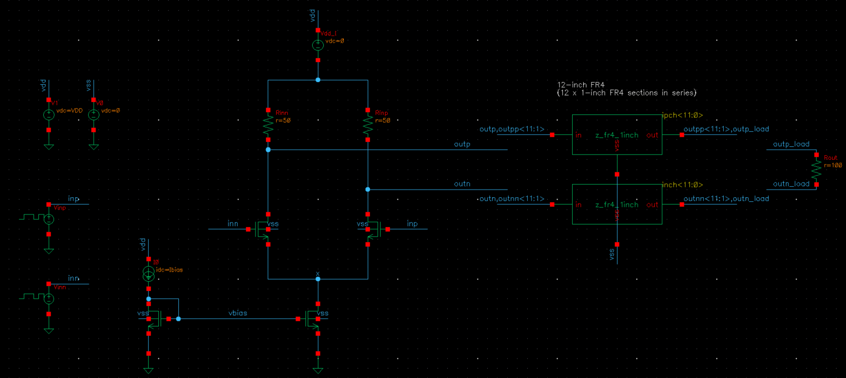
TB Schematics
LIB: analogLib
CELL: vprbs
Zero value: 0 V / 1 V
One value: 1 V / 0 V
Bit period: 83.33ps (1/12G)
Rise/Fall times: 2.5 ps
Edge type: linear
Trigger: Internal
LFSR Mode: PN32
IMAIN=10mA
m=100 L=LMIN
m=100 L=LMIN
m=200 L=4*LMIN
m=200 L=4*LMIN

Slide 6
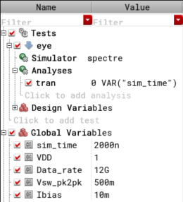
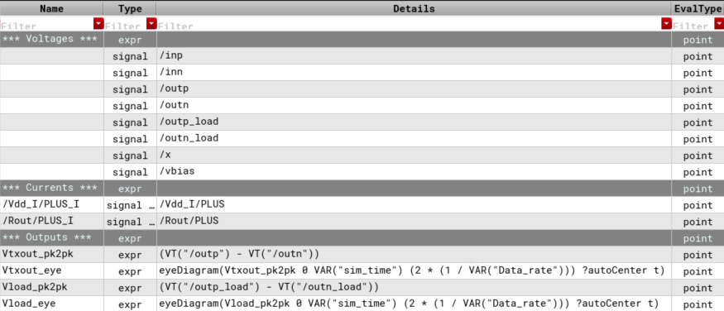
Analysis Setup
Eye Diagram

Slide 7
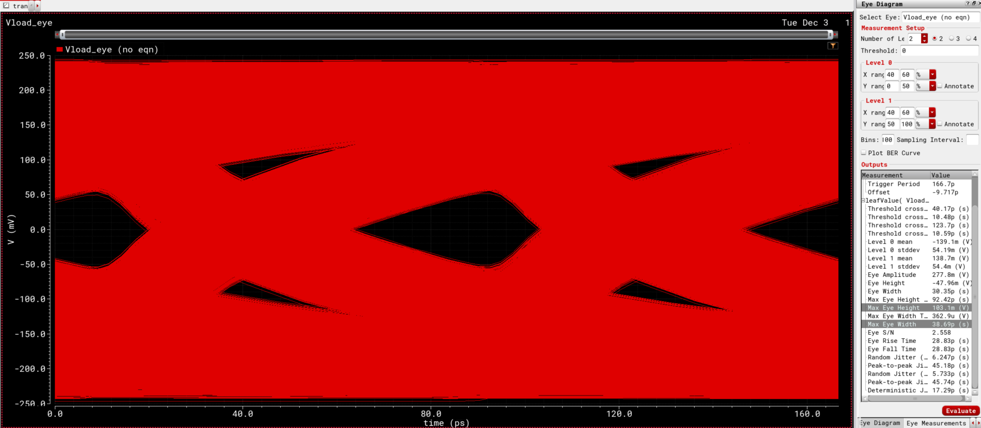
Eye Diagram
Measurements → Eye Diagram
103.1 mV
38.69 ps

Slide 8
2) Eye Diagram (with Equalization)

Slide 9
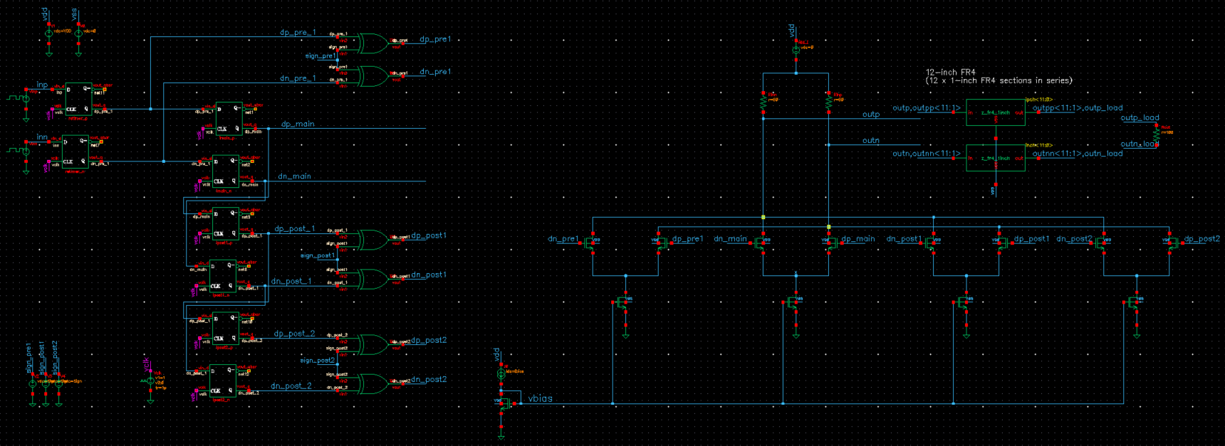
TB Schematics
Pre1
Main
Post1
Post2
IPRE1=0.6mA
IMAIN=10mA
IPOST1=2.9mA
IPOST2=1.4mA
m=12 L=4*LMIN
m=200 L=4*LMIN
m=58 L=4*LMIN
m=28 L=4*LMIN
m=200 L=4*LMIN

Slide 10
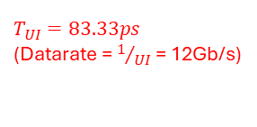

TB Schematics
$$T_{UI}=83.33ps$$
(Datarate = $1/{UI}$= 12Gb/s)
LIB: analogLib
CELL: vprbs
Zero value: 0 V / 1 V
One value: 1 V / 0 V
Bit period: 83.33ps (1/12G)
Rise/Fall times: 2.5 ps
Edge type: linear
Trigger: Internal
LFSR Mode: PN32
Pre1
Main
Post1
Post2
IPRE1=0.6mA
IMAIN=10mA
IPOST1=2.9mA
IPOST2=1.4mA
$$T_{clk}=83.33ps$$
(Data is sampled every $T_{clk}$ = every rising edge)
m=12 L=4*LMIN
m=200 L=4*LMIN
m=58 L=4*LMIN
m=28 L=4*LMIN
LIB: analogLib
CELL: vpulse
Voltage1: 1 V
Voltage2: 0 V
Period: 83.33ps (1/12G)
Rise/Fall times: 1 ps
Pulse width: 41.67ps (0.5/12G)
m=200 L=4*LMIN
LIB: ahdlLib
CELL: d_ff
Vlogic_high/low: 1/0
Vtrans_clk/Vtrans: 0.5
tdel: 1f
Rise/Fall times: 2.5 ps
LIB: ahdlLib
CELL: xor_gate
Vlogic_high/low: 1/0
Vtrans: 0.5
tdel: 1f
Rise/Fall times: 2.5 ps

Slide 11
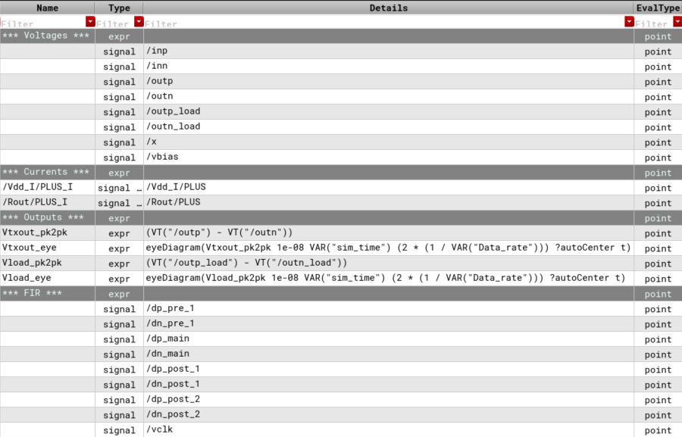
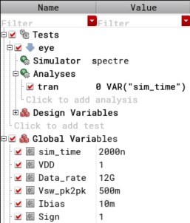
Analysis Setup
Eye Diagram
* The Sign bit of the XOR gates is set to 1, to subtract the cursor values from the main waveform.
* Delay time of 10ns is added to remove any settling time issues at the beginning of the simulation.

Slide 12
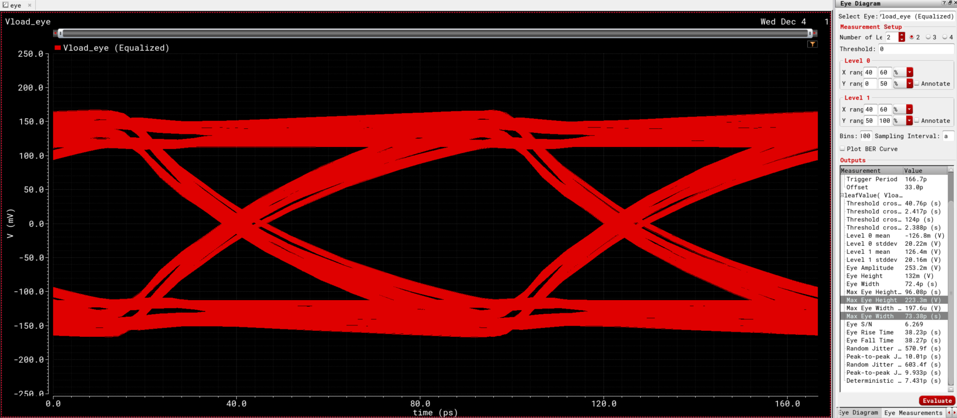
Eye Diagram
Measurements → Eye Diagram
223.3 mV
73.38 ps

Slide 13
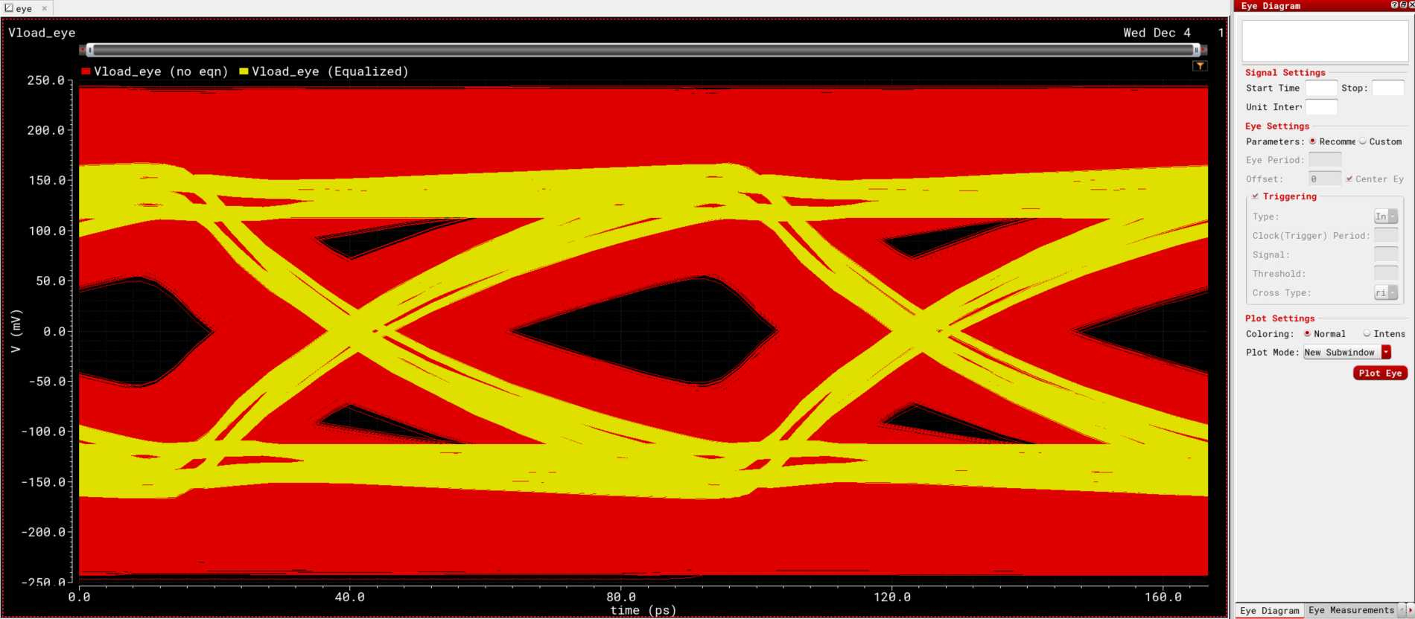
Eye Diagram (Comparison)
With Equalization, the swing pk2pk amplitude is reduced but the Eye opening is improved.

Slide 14
Eye Diagram (Comparison)
 | No Equalization | With Equalization (4-tap)
Eye Height (Max) | 103.1 mV | 223.3 mV
Eye Width (Max) | 38.69 ps | 73.38 ps
Swing (PK2PK) | 500 mV (–250mV ~ +250mV) | 328 mV (–164mV ~ +164mV)

